Slide 1


Trường Công Nghệ Thông Tin và Truyền Thông
Mandarin Square Capturing
Presented by Group 08

Slide 2


Group Members
Nguyen Thi Huong Giang
Nguyen Huu Tuan Duy
Nguyen Trung Dung
Duong Tung Giang
20204909
20204907
20204906
20204908

Slide 3




Outline
1. Detailed requirement
2. Use case and Interaction
3. Design

Slide 4

1. Detailed requirement
+ On the main screen:
• Start: start the game. For convenient, you do not have to create different difficulties
• Exit: exit the program. Be sure to ask users if they really want to quit the game
• Help: Show guide for playing the game
+ In the game:
• Gameboard: The gameboard consists of 10 squares, divided into 2 rows, and 2 half-circle on the 2 ends of the board. Initially, each square has 5 small gems, and each half-circle has 1 big gem. Each small gem equals 1 point, and each big gem equals 5 points.
• For each turn, the application must show clearly whose turn it is. A player will select a square and a direction to spread the gems. He got points when after finishing spreading, there is one empty square followed by a square with gems. The score the got for that turn is equal to the number of gems in that followed square (see the gameplay for more details about streaks)
• The game ends when there is no gem in both half-circles. The application must notify who is the winner and the score of each player

Slide 5
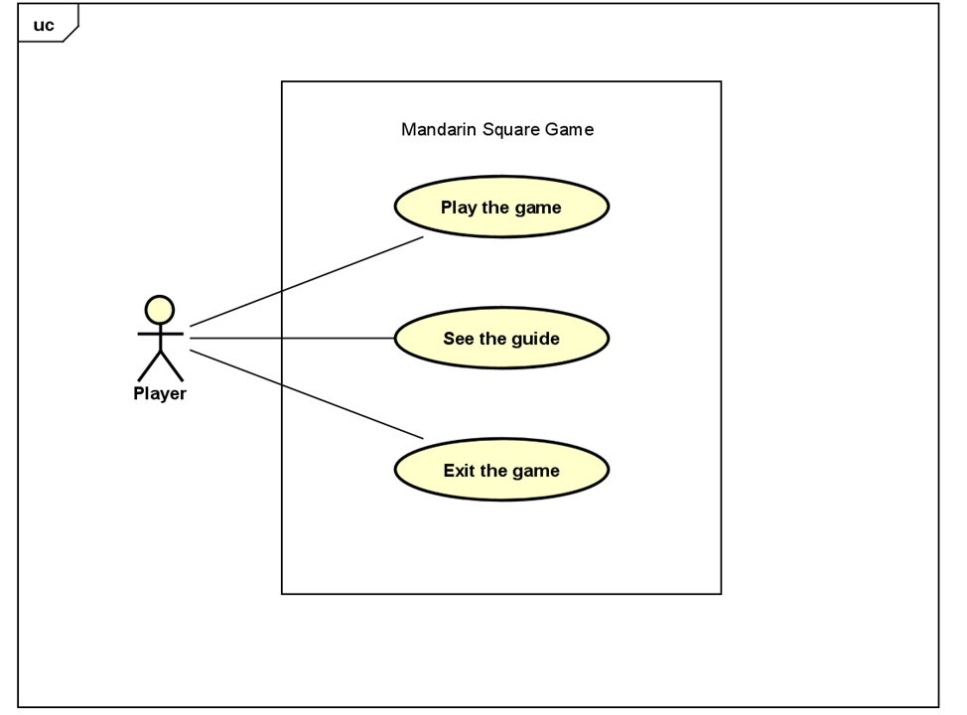
2. Use case and Interaction
Interaction:
+ User can start the game by clicking on
Play button
+ User can see the guide by clicking on
Help button
+ User can exit the game by clicking on
Exit button

Slide 6
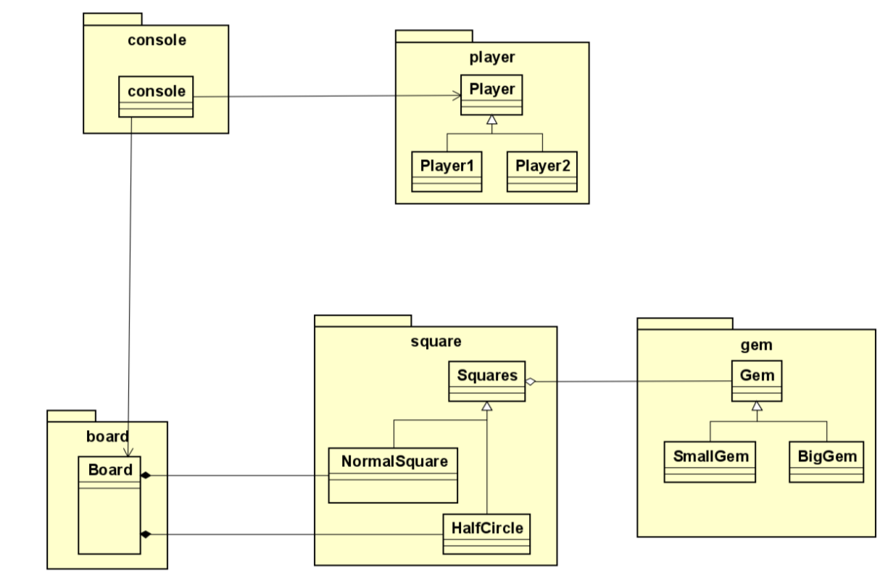
3. Design
3.1. General Class Diagram

Slide 7
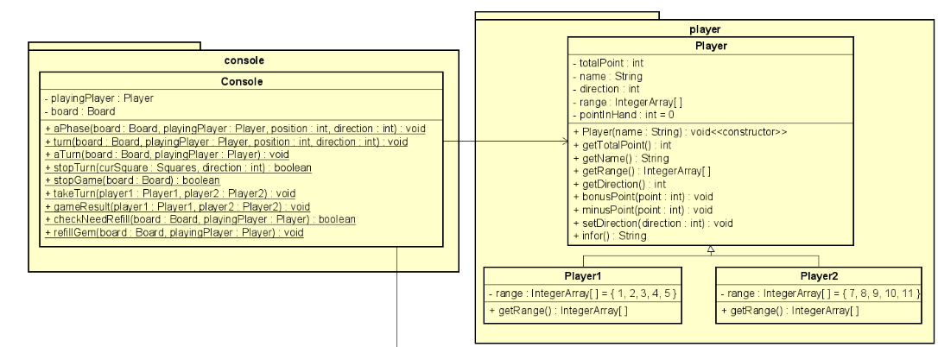
3. Design
3.2. Several Class Diagram

Slide 8
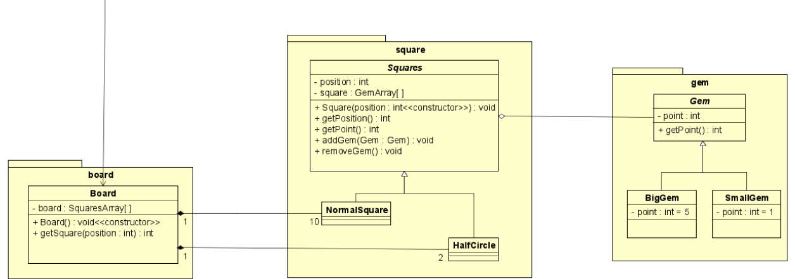

Slide 9
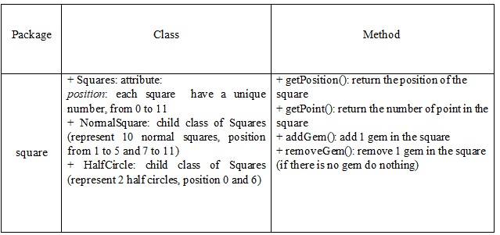
3. Design
3.3. Detailed for class/ method

Slide 10
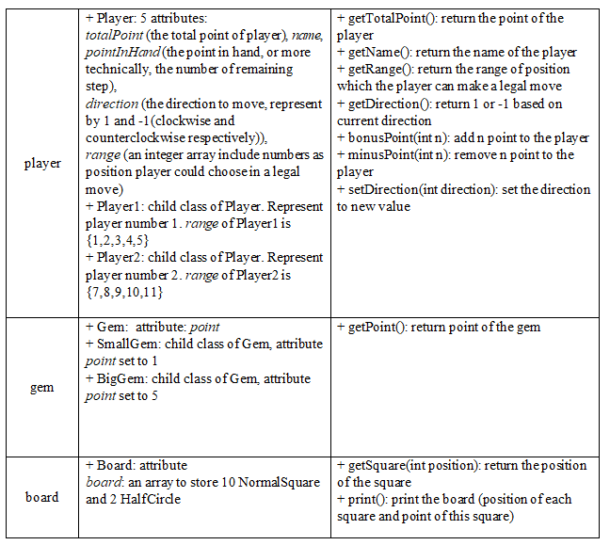

Slide 11
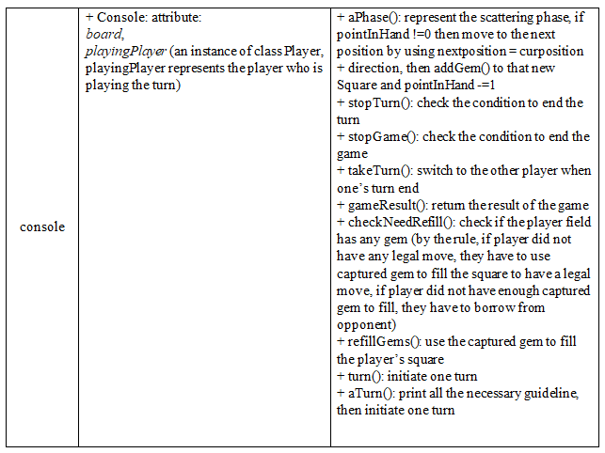

Slide 13

Thanks for listening
Any questions ?

